Slide 1
Minor Components Analysis
(MCA) Neural Networks
http://www.machineilab.org
64 pages

Slide 2
MCA Concept
PCA:
Given a set of stochastic data, search a direction such that the variance of all the projections on the direction of the data set is the largest one.
MCA:
Given a set of stochastic data, search a direction such that the variance of all the projections on the direction of the data set is the smallest one.

Slide 3
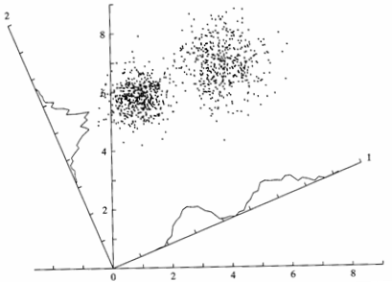
Minor component
Principal component

Slide 4
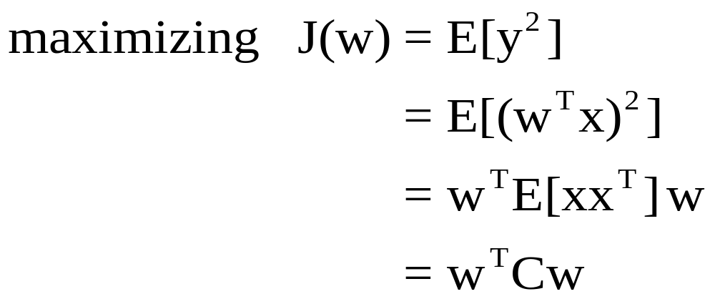
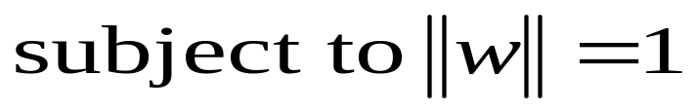
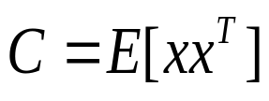
PCA:
where
is the correlation matrix.

Slide 5
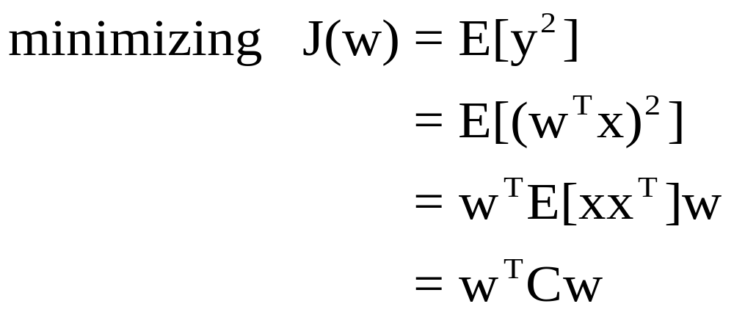
MCA:
where
is the correlation matrix.

Slide 6

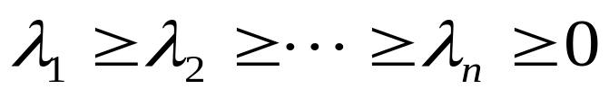
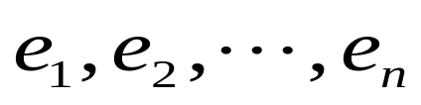
Correlation Matrix
Properties: (1) Symmetric; (2)Non-negative definite
Eigenvalues:
Eigenvectors:

Slide 7





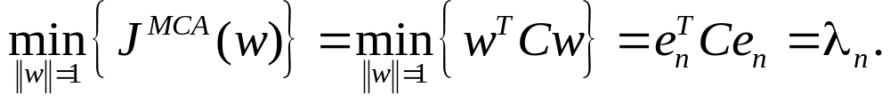
Conclusion: If
when
when
Then
Data set has the smallest variance along the eigenvector en associated with
the smallest eigenvalue of the correlation matrix.

Slide 8

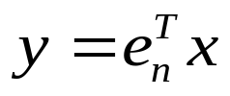
The MCA solution:
(minor component)
and
Problem: It is costly to calculate eigenvalues and eigenvectors of the matrix C with high dimension via algebraic approaches.

Slide 9


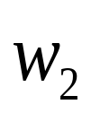




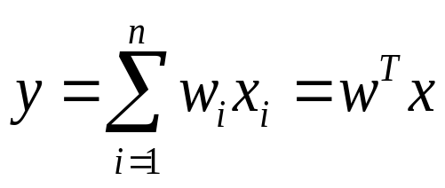
MCA Neural Networks
Can NN solve the problem of MCA?
total 61 pages

Slide 10
MCA Neural Networks
The advantages of neural network approach:
  without computing the correlated matrix C.
  Online computing
total 61 pages

Slide 11
MCA Neural Networks
Oja MCA algorithm - anti-Hebbian rule:
total 61 pages

Slide 12
Oja MCA algorithm
Oja PCA algorithm:
Oja MCA algorithm - anti-Hebb rule:
Character: Unstable
total 61 pages

Slide 13
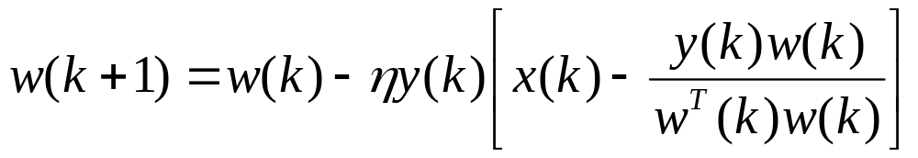


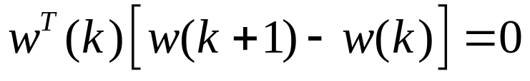
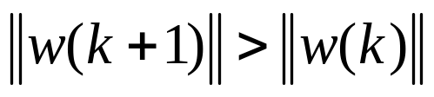

OJAn MCA algorithm
The normalized Oja MCA Algorithm:
Problem: norm divergence
total 61 pages

Slide 14
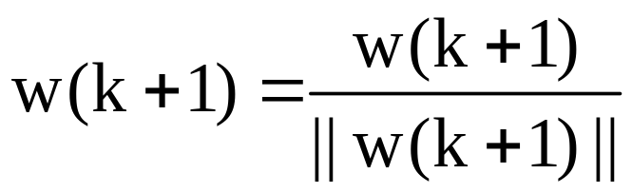
Modified OJA MCA Algorithm
Step 1:
Step 2:
(Dezhong Peng and Z. Yi, A Modified Oja-Xu MCA Learning Algorithm and Its
Convergence Analysis, IEEE Transactions on Circuits and Systems II, 2007,
54(4):348-352)
,
total 61 pages

Slide 15
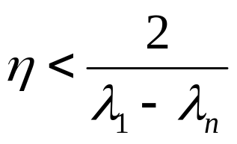
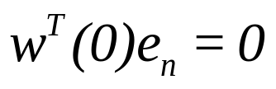
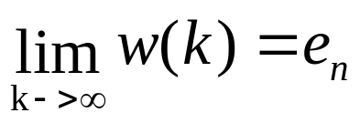
Convergence Analysis
If and only if
and
then
(sufficient and necessary condition)

Slide 16
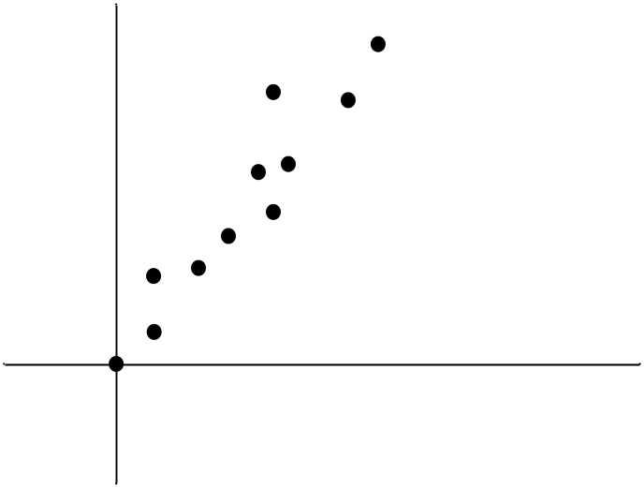
Line Fitting
line fitting:
total 61 pages

Slide 17
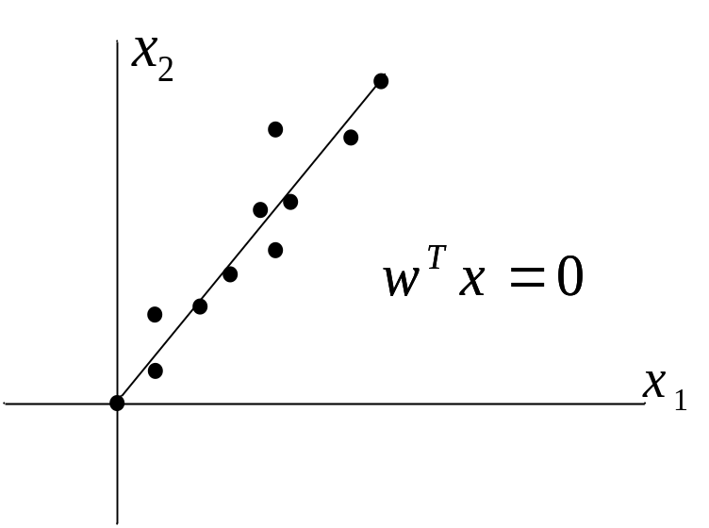
Line Fitting
line fitting:
total 61 pages

Slide 18
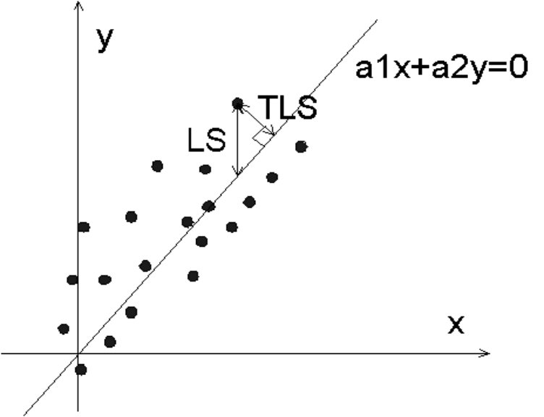


Line Fitting
Approaches for Line Fitting：
（1）Least Square (LS）
（2）Total Least Square (TLS）

Slide 19


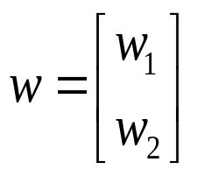
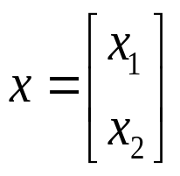
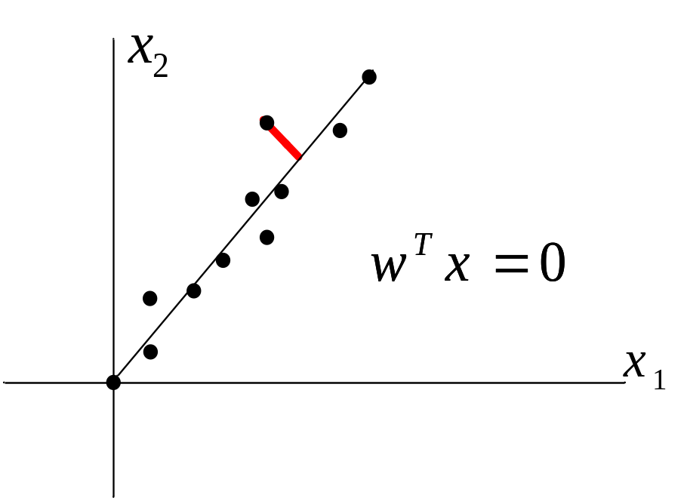
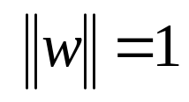
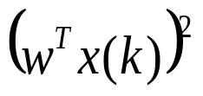
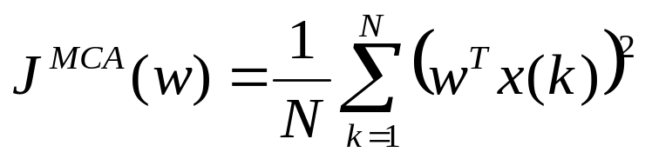
Line Fitting
Line equation:
or
where
w

Slide 20
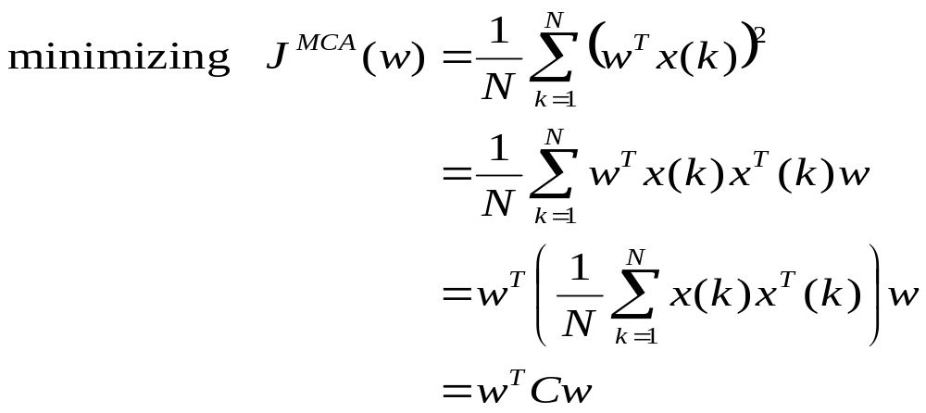
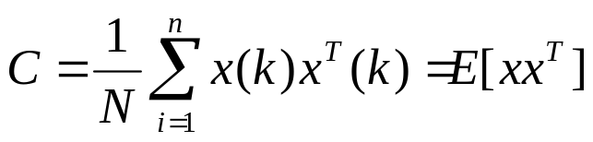
Line Fitting
correlation matrix
total 61 pages

Slide 21
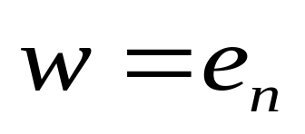
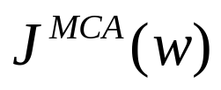
Line Fitting
The problem of line fitting is reduced to a problem of MCA.
When
is minimized.
total 61 pages

Slide 22
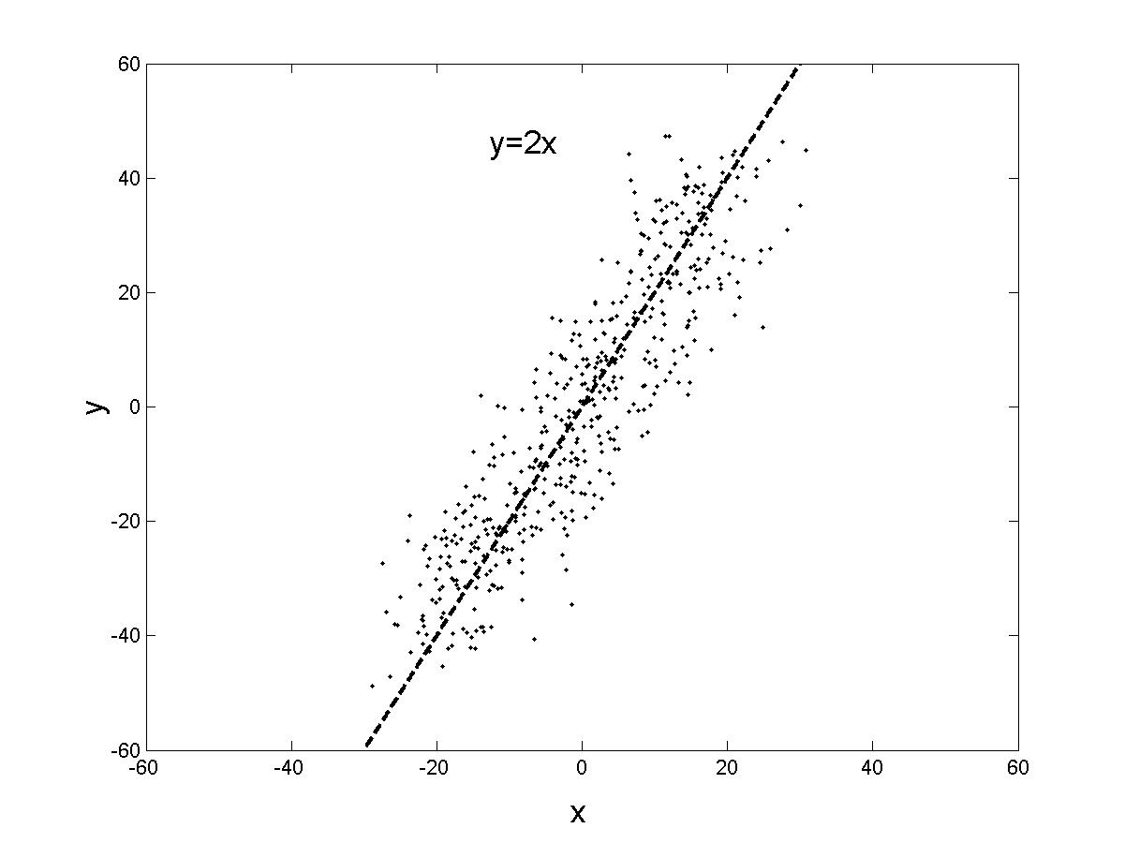
Line Fitting

Slide 23
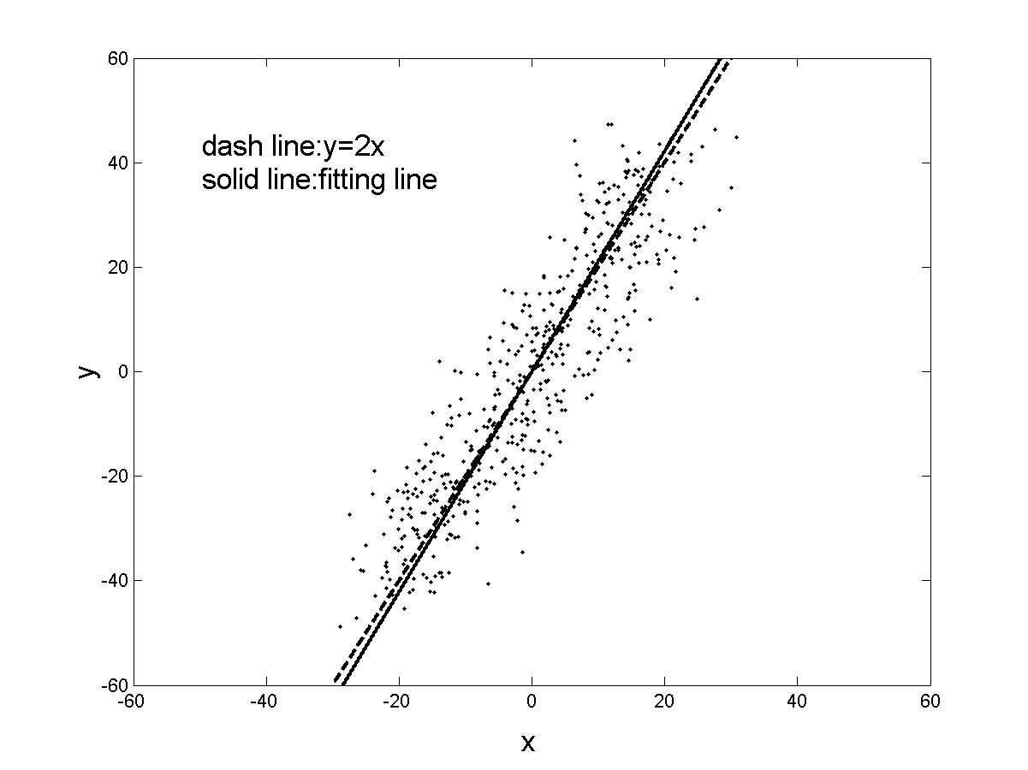
Line Fitting

